Slide 1
Video Activity
https://www.youtube.com/watch?v=vxVvwU9jFT8

Slide 2
Memory

Slide 3
Memory
The persistence of learning over time through the storage and retrieval of information.
Process of taking in information, saving it over time, and calling it to mind later.
Involves encoding, storage, and retrieval.
Memory as a net, not a bucket.

Slide 4
Information Processing Model
Analogy of the memory as a computer.
Encoding
The processing of information into the memory system.
Getting information into our brain.
Storage
The retention of encoded information over time.
Storing that information into our brain.
Retrieval
The process of getting information out of memory storage.
Getting the information back out of our brain.

Slide 5
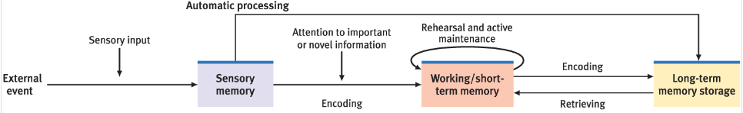
Information Processing Model
Sensory memory: encoding failure
Short-term memory/ working memory: interference
Long-term memory: decay

Slide 6
Sensory Memory
1st stage
Immediate, very brief recording of sensory information in the memory system.
Need to notice stimulus for it to enter sensory memory.
Once absolute threshold is activated, we aware of the stimulus. We must then make an effort to process it.
Holds information for milliseconds.
Encoding of information retrieved through physical senses (e.g. visual, auditory).

Slide 7
Sensory Memory
Make sure you have paper and pen ready.

Slide 8
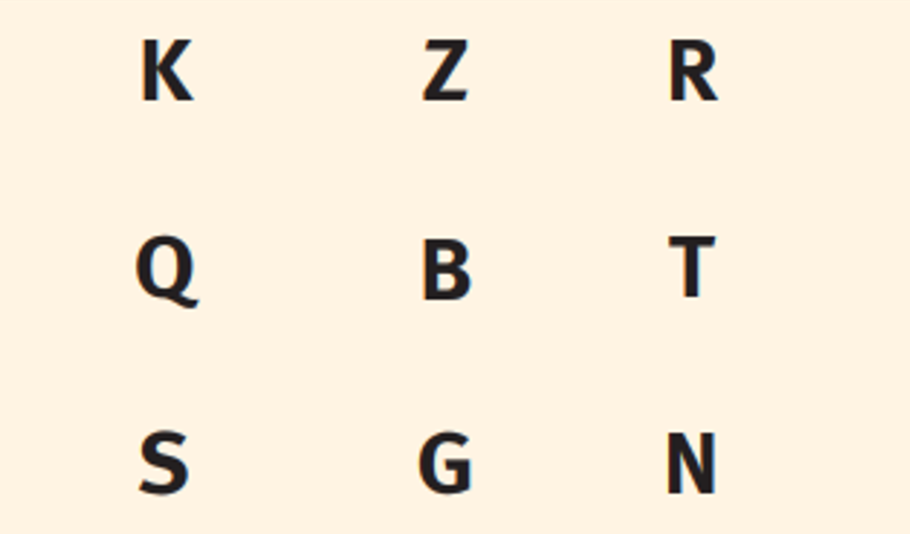
Sensory Memory

Slide 9
Sensory Memory
Write down what you remember.

Slide 10
Sensory Memory
Iconic memory
Momentary sensory memory of visual stimuli.
Photographic or picture-image memory lasting milliseconds.
Echoic memory
Momentary sensory memory of auditory stimuli.
Sounds and words can still be recalled within 3 or 4 seconds.

Slide 11
Short-term Memory
Short-term memory
Memory system that retains information for limited durations.
Middle step between sensory (registering and making sense of the information) and long-term memory (long-term storage).
Holds a few items briefly before the information is either stored in long term memory or forgotten/ discarded.
Limited storage capacity.
Duration?

Slide 12
Short-term/ Working Memory
Duration: Less than 30 seconds
Capacity: 7 plus or minus 2
Working memory
Update to concept of short-term memory.
Focuses on conscious, active processing of incoming information and of information retrieved from long-term memory.
Ability to manipulate information.

Slide 13
Working Memory
I will read a list of words.
After each word, say the previous word.

Slide 14
Short-term Memory
1 4 9 1 6 2 5 3 6 4 9 6 4 8 1

Slide 15
Short-term Memory
Write down as many numbers in order as you remember.
If you had more time to memorize, what techniques might you use?

Slide 16
Short-term Memory
1 4 9 16 25 36 49 64 81

Slide 17
Effortful Processing Techniques
Information is easier to remember when it is relevant, interesting, funny, etc.
Chunking: organizing information into meaningful units, allowing us to extend the capacity of our short-term memory.
Memory for chess positions (featuring grandmaster Patrick Wolff) – YouTube
Gave meaning to the positions
Organized pieces together
https://www.youtube.com/watch?v=WeMV7t_-ZRw

Slide 18
Effortful Processing Techniques
Rehearsal: the conscious repetition of information, either to maintain it in consciousness or to encode it for storage.
Maintenance rehearsal: repeating stimuli in their original form.
Elaborative rehearsal: adding meaning/ associations to information.
Mnemonics: memory technique to more easily remember material.
Elaborative rehearsal is typically more effective.
Deeper level of processing, builds associations.

Slide 19
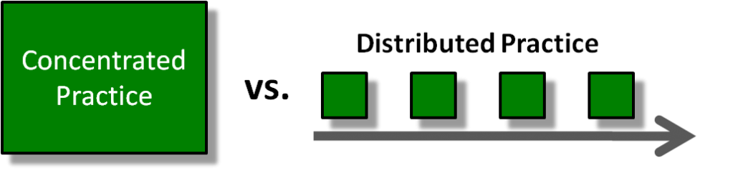
Spacing Effect
Spacing effect: tendency for distributed study or practice to yield better long-term retention than is achieved through massed study or practice.
Massed practice (cramming) vs. distributed study time
Need practice not only encoding, but retrieving information.
People underestimate how much they forget.

Slide 20
Memory
Listen as I read a list.

Slide 21
Memory
Write down what you remember.

Slide 22
Serial Position Effect
Elephant
Pony
Giraffe
Dog
Zebra
Cat
Gorilla
David
Panda
Bat
Dolphin
Koala
Rabbit

Slide 23
Serial Position Effect
Serial position effect: our tendency to best recall the first and last items on a list.
Primacy effect: information that comes first more likely to be remembered.
Recency effect: information that comes last more likely to be remembered.
Distinctiveness: distinct items more likely to be remembered.

Slide 24
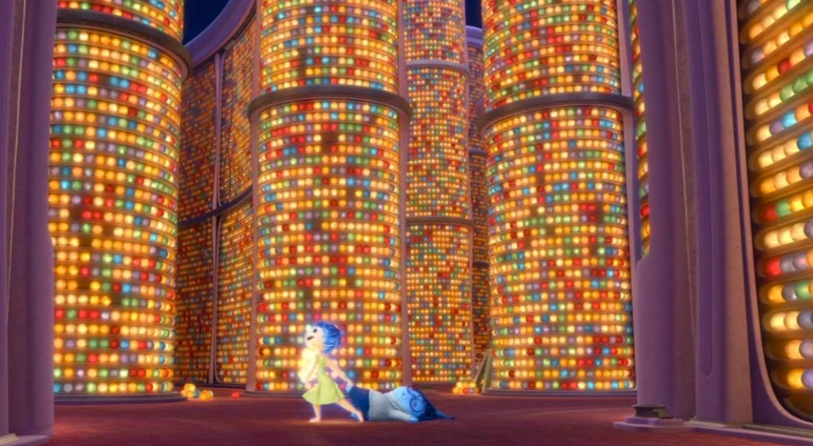
Long-term Memory
Long-term memory
The relatively permanent and limitless storehouse of the memory system.
Includes knowledge, skills, and experiences.
 | Short-Term | Long-Term
Capacity | 7 +/– 2 | Unlimited
Duration | < 30 seconds | Lifetime

Slide 25
Long-term Memory
Explicit memory: memory of facts and experiences that one can consciously know and declare.
Also called declarative memory.
Effortful processing.
Memories that we recall intentionally and of which we have conscious awareness.

Slide 26
Long-term Memory
Implicit memory: retention independent of conscious recollection.
Also called non-declarative memory.
Automatic processing.
Memories we don’t deliberately remember or reflect on consciously.
Implicit Memory Activity.

Slide 27
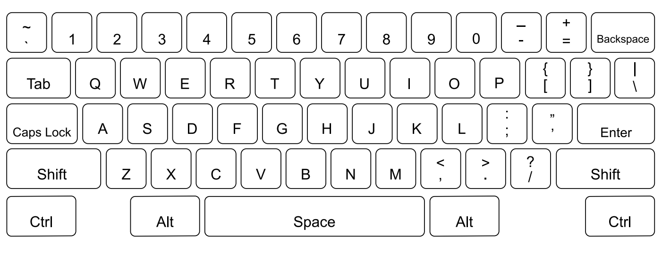
Implicit Memory

Slide 28
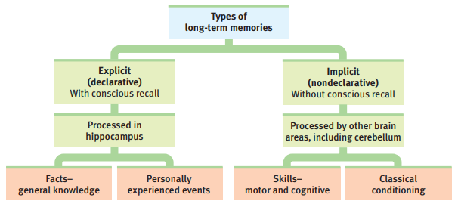
Long-term Memory

Slide 29
Explicit Memory
Semantic memory: our knowledge of facts about the world.
Names, dates, places, numbers, etc.
Episodic memory: our recollection of events in our lives.
Personal, first-hand experiences.
Tied to specific events/ situations.
Flashbulb memories: emotional memories that are extraordinarily vivid and detailed.
Stronger emotional experiences make for more vivid memories.
A confident, vivid memory is not necessarily an accurate one.

Slide 30
Episodic Memory
Autobiographical memory assessed with cue-word technique. Four major findings:
Most frequently reported memories were from the most recent time in life (within the last 10 years).
Number of memories prior to the preceding decade shows steep decline as a function of time since the event (forgetting).
Very few memories for events prior to age 3, regardless of participant’s current age (infantile amnesia).
Reminiscence bump: a positive bump in memory of people 35+ years old for events occurring when person was 18-24 years old.

Slide 31
Implicit Memory
Procedural memory: our knowledge of how to do things.
Motor skills and habits.
Takes time to develop.
Classical conditioning: making associations between stimuli.
Even without conscious awareness, we automatically process information around us.
Space
Time
Frequency

Slide 32
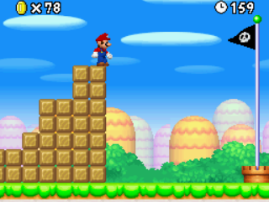
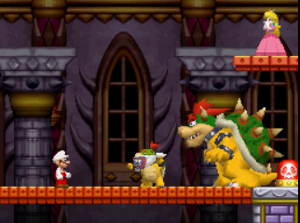
Implicit & Explicit Memory
Playing a familiar game might activate implicit and explicit memory.
Game controls: procedural (implicit).
Where to go and secrets: semantic (explicit).
Nostalgia about certain stages: episodic (explicit).

Slide 33
Implicit vs. Explicit Memory
Brain damage research shows that explicit and implicit memory are separate.
Case study: H.M.
Hippocampus removed in effort to control seizures.
Could not form new explicit memories.
Could still learn new procedural tasks.
HM and the tracing task - Intro to Psychology - YouTube

Slide 34

Three Processes of Memory
How we transfer information to long-term memory:

Slide 35
Encoding
Encoding: the process of getting information into our memory banks.
To encode, we must be attending to the stimuli.
Many of our everyday experiences do not get encoded.

Slide 36
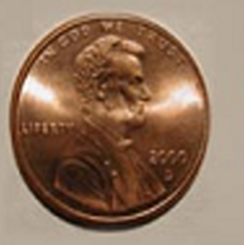
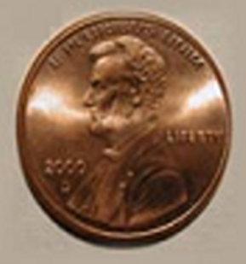
A
B

Slide 37
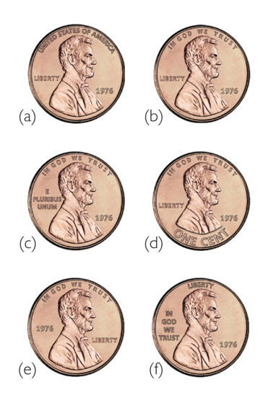

Slide 38
Levels of Processing
Read through the following list of words.
As you read through, repeat each word for a few seconds.
For example, if the word is insect, you would say “insect, insect, insect. . .” then proceed to the next word.

Slide 39
Levels of Processing
Toothbrush
Thermometer
Jewelry
Tuxedo
Washcloth
Bandage
Trampoline
Chain
Knife
Balloon
Carpet
Coat
Matches
Flashlight

Slide 40
Levels of Processing
Write down the words that you remember.

Slide 41
Levels of Processing
Read through the following list of words.
Imagine that you are stranded in the middle of a vast grassland in some foreign country, where you need to find food and water and protect yourself from wild animals.
As you go through the list, spend a few seconds on each word, thinking about how useful this item would be for survival under these conditions.
Think about giving a rating to each item for how useful it would be under these conditions.
Rating from 1 (useless) to 5 (extremely valuable).

Slide 42
Levels of Processing
Rollerblades
Umbrella
Hammock
Binoculars
Encyclopedia
Saxophone
Pencil
Camera
Mirror
Scissors
String
Bottle
Envelope
Candy

Slide 43
Levels of Processing
Write down the words that you remember.

Slide 44
Levels of Processing
How many words did you remember from the first list?
How many words did you remember from the second list?
Did you remember more words from the first list or the second list?

Slide 45
Levels of Processing
Levels of processing: how deeply information is encoded.
How easily a memory is retrieved depends on the number or types of associations you form.
Shallow processing vs. deep processing (maintenance rehearsal vs. elaborative rehearsal).
The more deeply we encode something, the better we remember it.

Slide 46
Storage
Storage: process of keeping information in memory.
Brain distributes components of a memory across network of locations.
Schema: organized knowledge structure or mental model that we’ve stored in memory.
Memory is associative, we store similar information together.
Pros: helps us make sense of the world.
Cons: can oversimplify things and cause us to use stereotypes.

Slide 47
Retrieval
Retrieval: reactivation or reconstruction of experiences from our memory stores.
Retrieval errors:
Memories are reconstructive and affected by our beliefs and expectations.
When no cues are available, ability to retrieve information can be reduced. Require a cue to get started.
Tip of the tongue phenomena: knowing that we know something but being unable to access it, a failure of retrieval.

Slide 48
Ways to Access Memory
Recall: measure of memory in which person must retrieve information learned earlier.
Recognition: measure of memory in which person need only identify items previously learned.
Testing effect: enhanced memory after retrieving rather than simply re-reading.
Memory is strengthened when you practice not only encoding information, but retrieving it as well.
Relearning: measure of memory that assesses the amount of time saved when learning material for a second time.

Slide 49
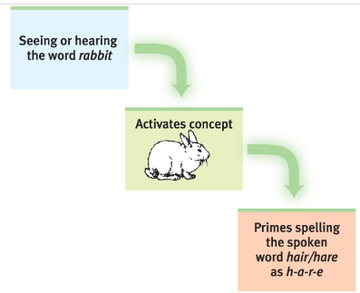
Retrieval Cues
Tastes, smells, and sights can evoke recall of associated events/ experiences.
Priming: activation, often unconscious, of particular associations in memory.
Encoding specificity: phenomenon of remembering something better when the conditions under which retrieval occurs are similar to the encoding conditions.

Slide 50
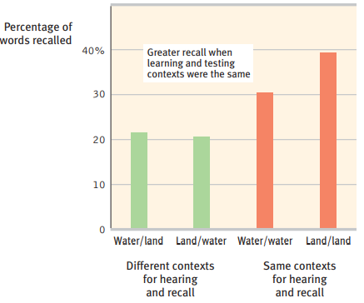
Encoding Specificity
Context-dependent learning: superior retrieval of memories when external context of original memories matches the retrieval context.

Slide 51
Encoding Specificity
State-dependent learning: superior retrieval of memories when the organism is in the same physiological/ psychological state as it was during encoding.
Mood-congruent memory: tendency to recall experiences that are consistent with one’s current good or bad mood.
Retrospective bias: current mood distorting memories of our past.

Slide 52
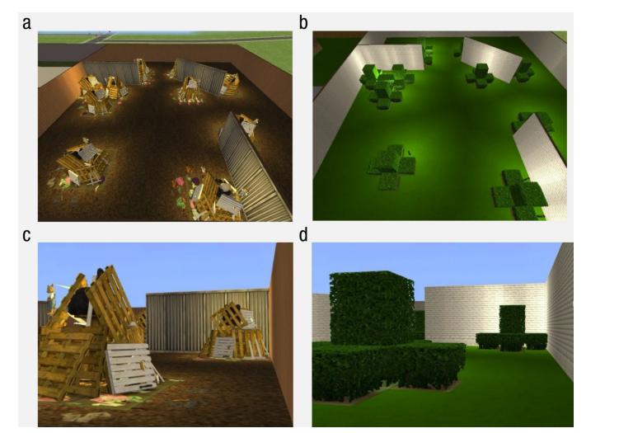
Déjà-vu
Déjà-vu: feeling that “I’ve experienced this before.”
Cues from current situation unconsciously trigger retrieval of an earlier experience (priming).
Dual processing
Cleary & Claxton (2018)

Slide 53
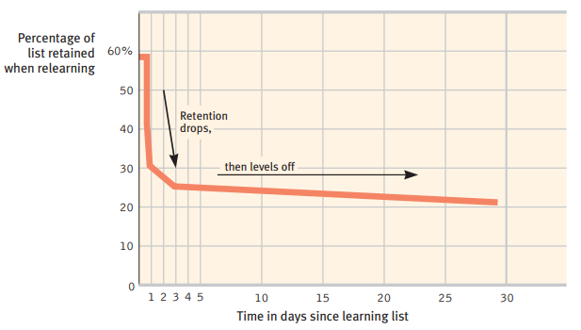
Forgetting
Encoding failure: selectively attend to only a small percentage of stimuli.
Decay: fading over time.

Slide 54
Forgetting
Interference: loss of information from memory due to competition from additional incoming information.
Sleep soon after encoding improves memory: strengthens memory formation and prevents interference from occurring.
Proactive interference: disruptive effect of prior learning on recall of new information.
Retroactive interference: disruptive effect of new learning on recall of old information.

Slide 55
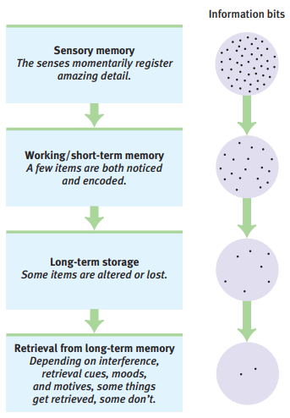

Slide 56
Memory Activity
Listen as I read a list of words.

Slide 57
Memory Activity
What words do you remember?

Slide 58
Word List
Honey
Sour
Heart
Tooth
Nice
Sugar
Chocolate
Taste
Fruit
Tart
Candy
Soda
Cake
Cookies
Dessert
Ice cream

Slide 59
Memory Illusion & Distortion
Memory illusion: a false but subjectively compelling memory.
Our brains go beyond available information to make sense of the world.
Memory is associative: thinking about one thing can lead you to think about other related things.
Memory distortion: remembering things quite differently from the way they originally occurred and sometimes remembering things that never occurred at all.

Slide 60
False Memories
Garry et al. (1996)
Participants asked if they had ever experienced unlikely childhood events.
Two weeks later, participants given a list of events and asked to rate likelihood that each event occurred in their childhood.
Imagined scenario rated as more likely than others.
Hessen-Kayfitz & Scoboria (2012)
Hot air balloon photos.
How reliable is your memory? | Elizabeth Loftus – YouTube

Slide 61
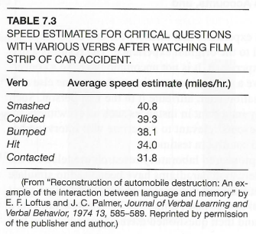
False Memories

Slide 62
N=63
Smash: 23.97 mph
Contact: 19.13 mph
t = 1.62
p = 0.06, ns

Slide 63
False Memories
Misinformation effect: the tendency of false or misleading information presented after the fact to be mistakenly incorporated into memory.
Source amnesia: attributing to the wrong source an event we have experienced, heard about, read about, or imagined.
Might mis-remember whether the source was reliable.

Slide 64
Eyewitness Testimony
Problems with eye witness testimony:
Most common cause of wrongful convictions.
Eyewitness confidence does not correlate well with accuracy.
Not good at identifying people of other races.
Weapon focus: tendency to focus on the weapon rather than perpetrator’s appearance.
Suggestive or leading interview questions can lead to false memories.
https://www.youtube.com/watch?v=uGDRS30ZBLI

Slide 65
Amnesia
Amnesia: inability to remember some or all information, either temporarily or permanently.
Retrograde amnesia
Inability to recall memories of the past.
Can form new long-term memories.
Uncommon to lose all memories of the past.

Slide 66
Amnesia
Anterograde amnesia
Inability to form new long-term memories.
Information contained in short-term memory not transferred to long-term memory.
Living in the present.
Clive Wearing - The man with no short-term memory – YouTube
https://www.youtube.com/watch?v=mRUuIRWwOIY

Slide 67
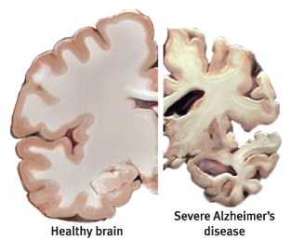
Alzheimer’s
Impairments in memory: recent memories go first.
Accumulation of harmful proteins in the brain and deterioration of neurons.
Factors that could prevent Alzheimer’s: being physically active, having strong social networks, being intellectually active (learning new skills).

Slide 68
In Video Games
Retrieval cues:
Quest logs
Game maps
Hints
Recaps
Tutorials
How to ensure that players remember the information that you want them to remember?
Primacy, recency, distinctiveness
Frequency
Recall vs. recognition
Deeper levels of processing

